Slide 1
Maths at Edwinstree

Slide 2
Teaching for Mastery
Mastering maths means pupils of all ages acquiring a deep, long-term, secure and adaptable understanding of the subject.
Achieving mastery means acquiring a solid enough understanding of the maths that’s been taught to enable pupils to move on to more advanced material.
ncetm.org.uk

Slide 3
Maths Home Learning
This consists of three separate tasks:
Quiz accessed through Satchel One
Puzzle Home Learning – given as a hard copy
Challenge Home Learning – given as a hard copy

Slide 4
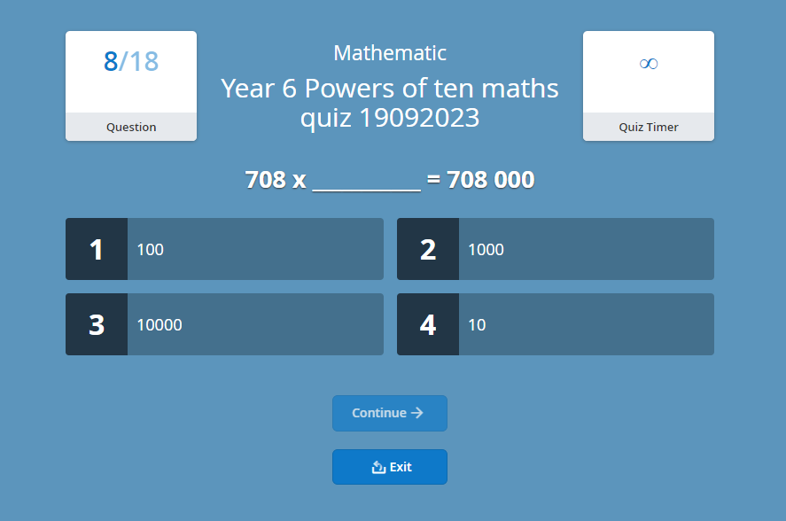

Slide 6
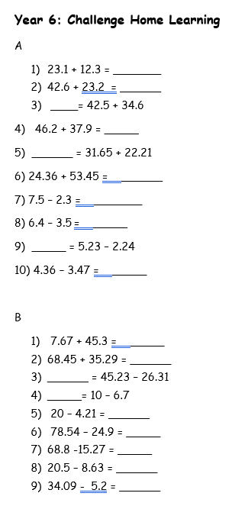

Slide 7
Science at Edwinstree
Health and Safety
Curriculum
Home Learning

Slide 8
Health and Safety
Uniform:
Appropriate footwear
Polished filled in shoes.
Long hair tied up
No jewellery
No coats
Behaviour:
Attentive listening
Following instructions
Safe movement
Only pupils who are safe can be in the lab and take part.

Slide 9
Curriculum
Space (stargazing evening)
Forces
Properties of Materials
Living Things and Life Cycles

Slide 10
Home Learning
Set on Satchel One on a Monday
Different types (spelling test, project, comprehension, research)
To consolidate learning or practise skills.

Slide 11
English at Edwinstree
Curriculum - Reading - Writing – including grammar and punctuation - Handwriting and spelling
Home learning
Reading at home

Slide 12
Curriculum
6 hours a week: Reading
Writing - Grammar and punctuation
Spelling
Handwriting

Slide 13
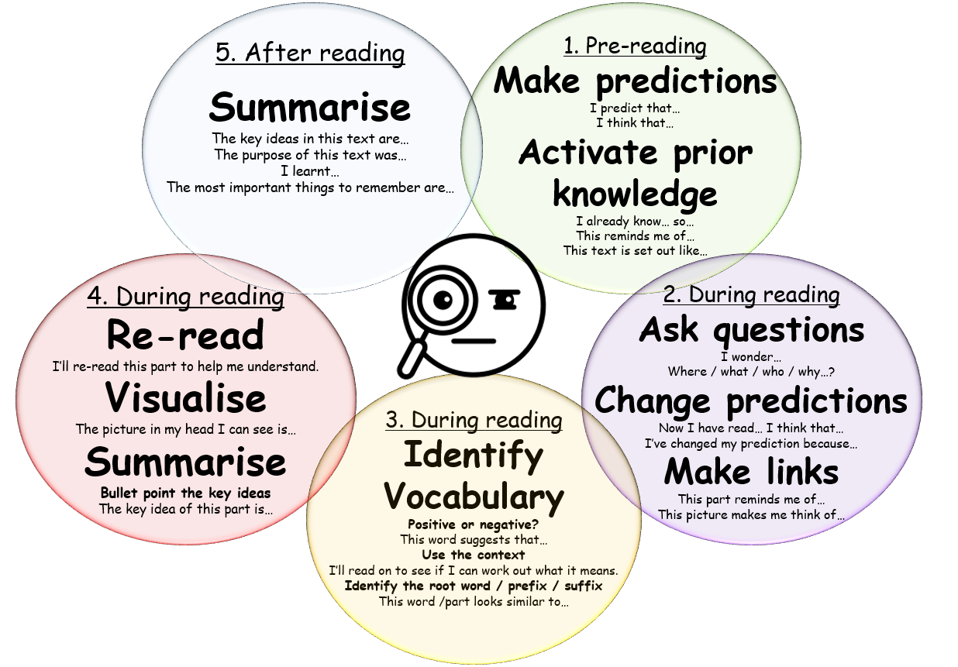
Reading
Read as a writer – author intent
Read as a reader – making sense of a text
Content domains - Vocabulary - Inference - Prediction - Explanation - Retrieval - Summarising

Slide 14
Writing
Purposes: - Writing to entertain - Writing to inform / explain - Writing to persuade - Writing to discuss
Grammar and punctuation
Proof read and edit – green pen

Slide 15
Handwriting and spelling
Black or blue pen
Weekly spelling lessons
Spelling detectives and pattern finders
Brave spellers!
Home learning

Slide 16
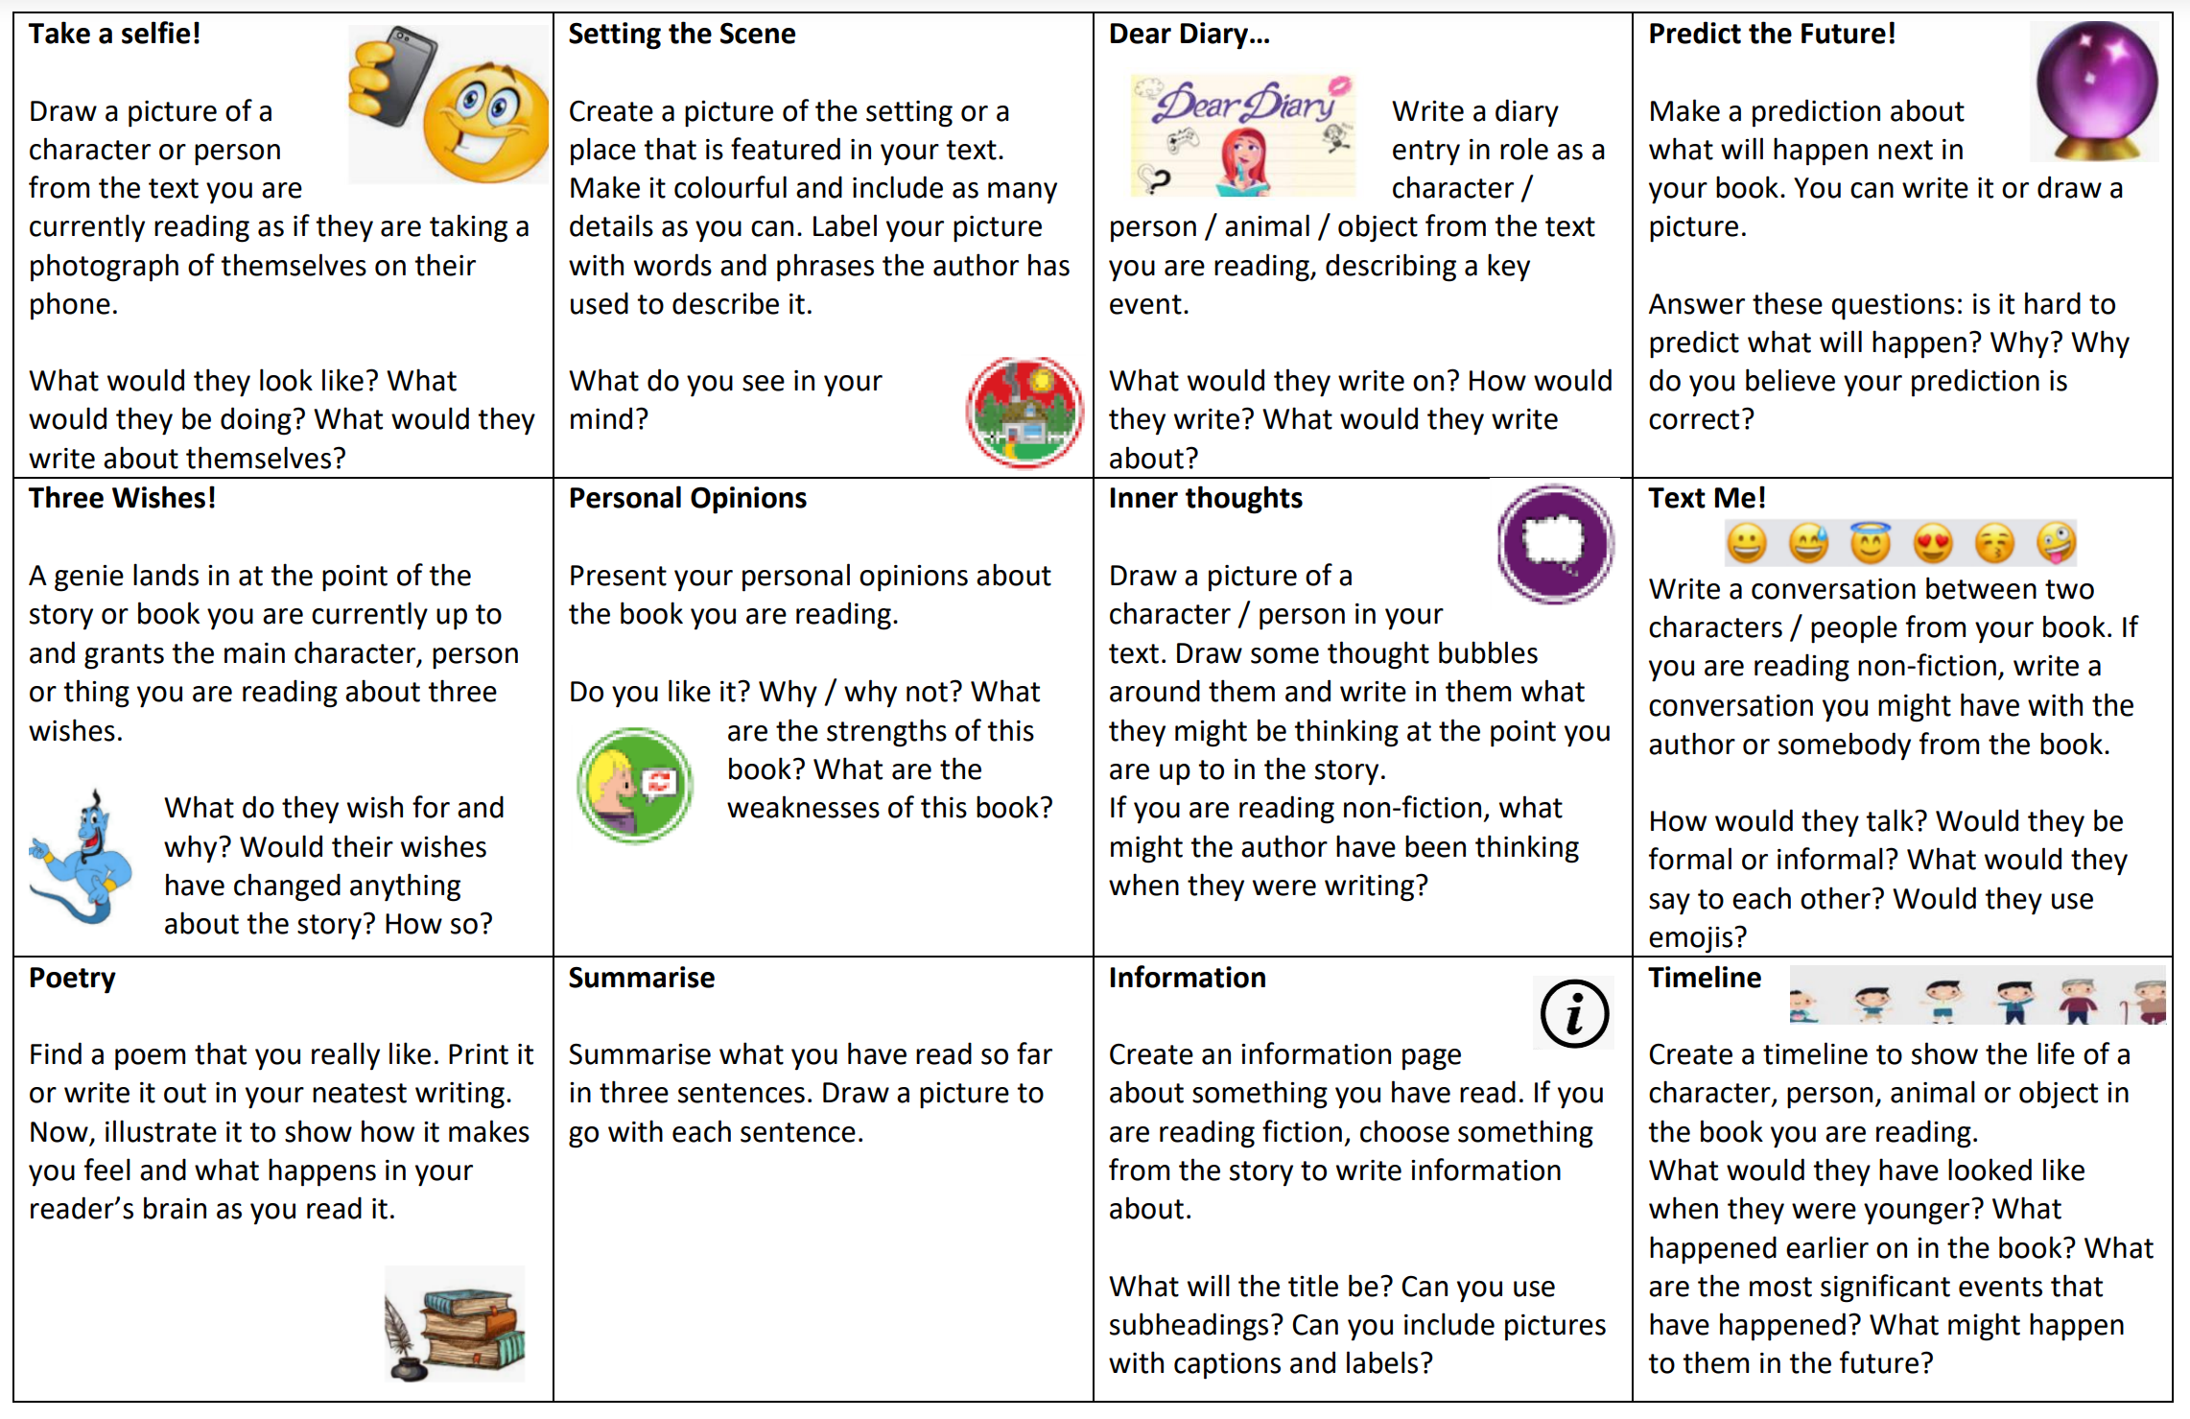
Home learning
Set weekly
Grammar / punctuation
Spelling
Reading - 20 minutes daily - choose one task weekly - Book Talk in class

Slide 17
Reading at home
Reading… - improves memory and focus - expands knowledge - develops vocabulary - strengthens writing skills - builds confidence - lowers stress - stimulates imagination - makes you more empathetic - allows children to ‘see themselves’
Fiction books
Non-fiction books
Poems
Magazines
Newspapers
Comics
Encyclopaedias
Recipes
Blogs

Slide 18
Any book that helps a child to form a good habit of reading, to make reading one of their needs, is good for them. - Maya Angelou

