Slide 1
SATS Monday 11th May 2026 – Thursday 14th May 2026. Writing Assessment completed by end June 2026
Monday 11th May: Spelling, Punctuation & Grammar – Paper 1
Monday 11th May: Spelling Punctuation & Grammar – Paper 2
Tuesday 12th May: English Reading
Wednesday 13th May: Maths Paper 1 (Arithmetic)
Wednesday 13th May: Maths Paper 2 (Reasoning)
Thursday 14th May: Maths Paper 3 (Reasoning)

Slide 2
The Link between home learning and SATS Success
Over the years we have found that students who complete home learning are more likely to be successful in their SATs.
We believe that home support has a great role to play – your interest in home learning can really make a difference to test outcomes!
Home learning support is provided in school – please speak to a member of staff if you would like to discuss this.

Slide 3
Easter Home learning
We have found that doing a little thinking is good for wellbeing and students are quicker to engage on their return to school.
English
Please read daily and talk about what you are reading.
Students will be sent home practice test papers.
Maths
Students will be set specific pages from their CGP book: little and often is best.
Maths practice papers.
Go to gov.uk website or satspapers.org.uk to find old SATS papers if your child would like to use these.

Slide 4
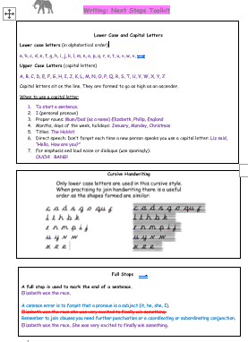
GPS and Writing
To reach ‘working at standard’ students need to have evidence that they can join their handwriting and spell most of the statutory spellings.
Handout:
Writing Toolkit.
And Statutory Spellings.

Slide 5
Writing Assessment completed by the end of June 2025
Please be aware, that it is important to attend school so we can continue to improve writing after SATS.
Students are teacher assessed on their independent writing over time. We focus fully on writing until the end of June when we submit our assessments.

