Slide 1

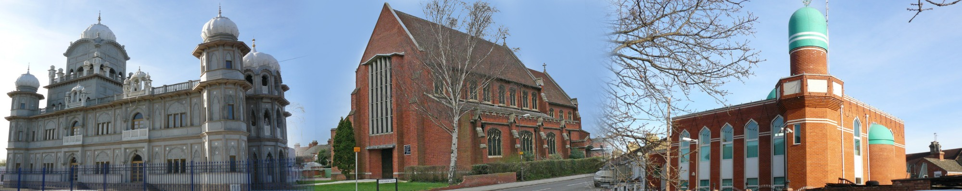
What are the times?
You need to arrive at Edwinstree at 8:15 am.
Why so early? Travelling during a busy time with traffic!
We will do all our visits, eat lunch and then leave at 1:30pm.
We hope to be in school by 2:30 pm- You will be able to have a play either in the field or in the hall before end of normal school day.

Slide 2
What do I bring?
You need a rucksack/bag with:
-Packed lunch (we will come back to this later)
-Drink- Water bottle
-Pencil case with pens/pencils

Slide 3
What will we do at each place?
At each venue you will get to look around and see what the places of worship we have studied this year look like in real life!
Can anyone remember what happens to the Guru Granth Sahib each night!?
You will also be able to ask questions and listen to our Guide.

Slide 4
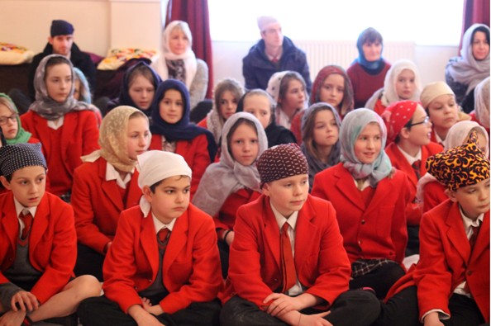
What will we wear?
Normal School Uniform.
You will need to take off your shoes so make sure you have socks on and let us know if you need any help getting your shoes on/off.
Bring a head- scarf (super light)/ beanie hat from home, if possible, if not they can lend you one. My Nannie has lots of scarves so your grandparents might too!
We will all wear one in the Gurdwara, and then only females will wear in the Mosque.

Slide 5
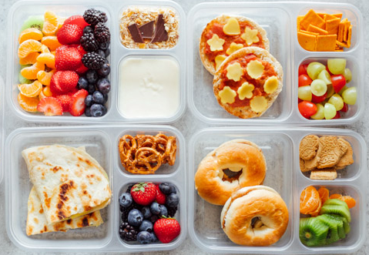
What will we eat?
Vegetarian Pack Lunches- no meat or fish.
Cheese/Jam sandwiches, houmous wraps, pizza, pasta, fruit salad, crisps, biscuits, yoghurts are all great ideas!

Slide 6
Questions…
Will we do any praying or be asked to join a religion?
No! Just like RE at Edwinstree, we would never try and make anyone join a religion. The guides will tell you about what THEY do and how THEY worship.
You might want to tell them about what YOU do too!

Slide 7
Questions…
What if I do or say something “wrong”?
Firstly- it won’t be “wrong”- you are learning and it is ok!
We can help educate you and resolve it.
If you’re ever unsure you can always ask a teacher or the guide.

Slide 8
I am not going…
You will be expected in school.
You will have a timetable for that day to follow- we will try to ensure you have some fun too!
You will be told in the morning power-point or via paper copies.

